Slide 1
Online learning management system
Submitted by:
Md. Fahim Ahamed Tonmoy
ID: 20232119010
Shaharul Islam
ID: 20232027010
Shree Bishal Kumar Ghosh
ID: 20232019010
Irina Sultana
ID: 20232143010
Submitted To:
Zahrul Jannat Peya
Assistant Professor
Department of Computer Science and Engineering
North Western University, Khulna

Slide 2

INTRODUCTION
A simple and user-friendly platform that allows students and teachers to manage courses, assignments, and learning activities online anytime, anywhere. It enhances communication and provides flexible access to learning resources.

Slide 3
BACKGROUND
Growing demand for E-learning
Flexible learning from anywhere
Technology improving education

Slide 4


IDEA DESCRIPTION
ALL IN ONE
One platform for all study needs
Upload, learn, and communicate
Designed for modern education
01
02
03

Slide 5
KEY FEATURES AND OBJECTIVES
Key Features:
Objectives:
Login for student, teacher and admin roles
Courses, quizzes, exams and materials
Secure data and progress tracking
Notifications and communication
Improve learning accessibility
Enhance student-teacher interaction
Efficient course and result management

Slide 6
Workflow
For Courses:
For Tests:
Login
Dashboard
Courses
Submit Assignments
Take Exams
View Result

Slide 7
TARGET POPULATION AND BENEFITS
Students and Teachers
Schools, colleges, universities
Training centers & professionals
Cost-efficient and time-saving
Learning without boundaries
Promotes digital skill growth
Supports remote education
Target Populations:
Benefits:

Slide 8
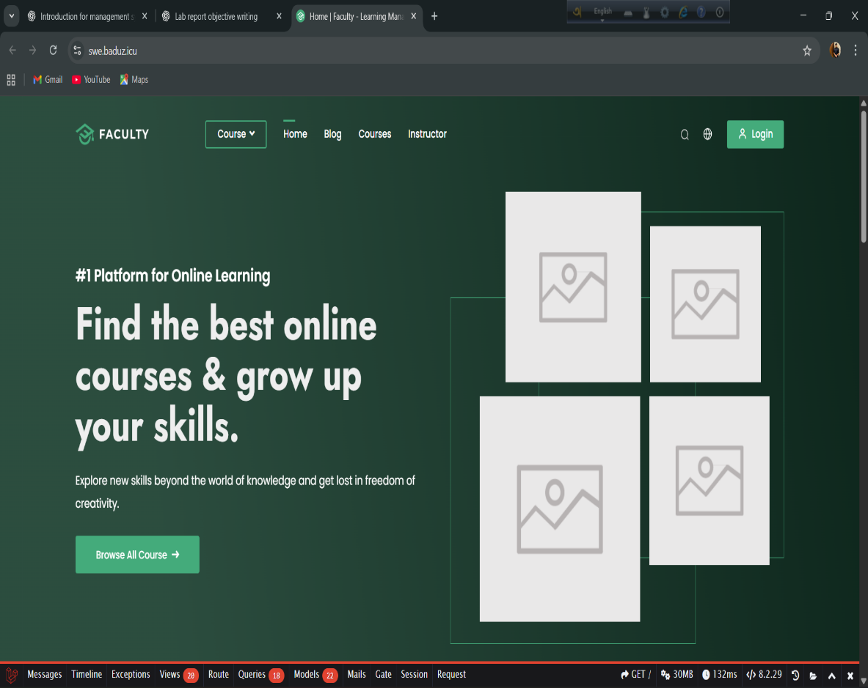
CONCLUSION
Smart system for modern learning
Improve teaching efficiency
Better accessibility for everyone
Save time & reduces errors

